Slide 1

Online Blog Platform
A console-based application built with Java, Hibernate and a layered architecture. Presented by Jayakanth— course project demo for computer science students and instructors.

Slide 2

Introduction & Project Goal
The objective was to build a Console-Based Online Blog Platform the right way: a professional, layered design that keeps code clean, maintainable and scalable. Implemented entirely in Java with Hibernate for persistence and Maven for dependency management.

Slide 3



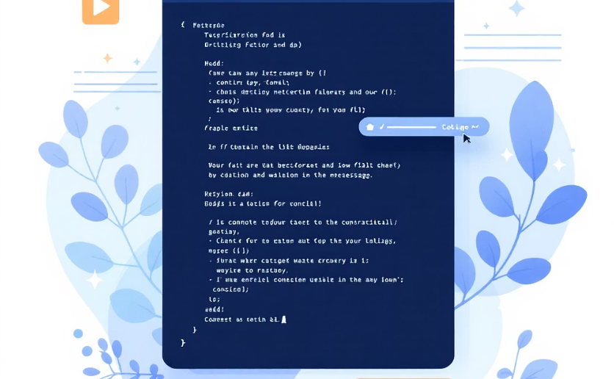
Key Features — Overview
User Management
Post Management
Register, log in, and track current session state. Basic validation and session handling in the Service Layer.
Create posts, list all posts, and delete own posts. Ownership checks enforced by business logic.
Comment Management
Read and add comments to any post. Comments stored with author and timestamp metadata.
The platform supports the essential blog workflows while remaining lightweight and easy to extend. Each feature maps to services and DAOs in the layered design.

Slide 4

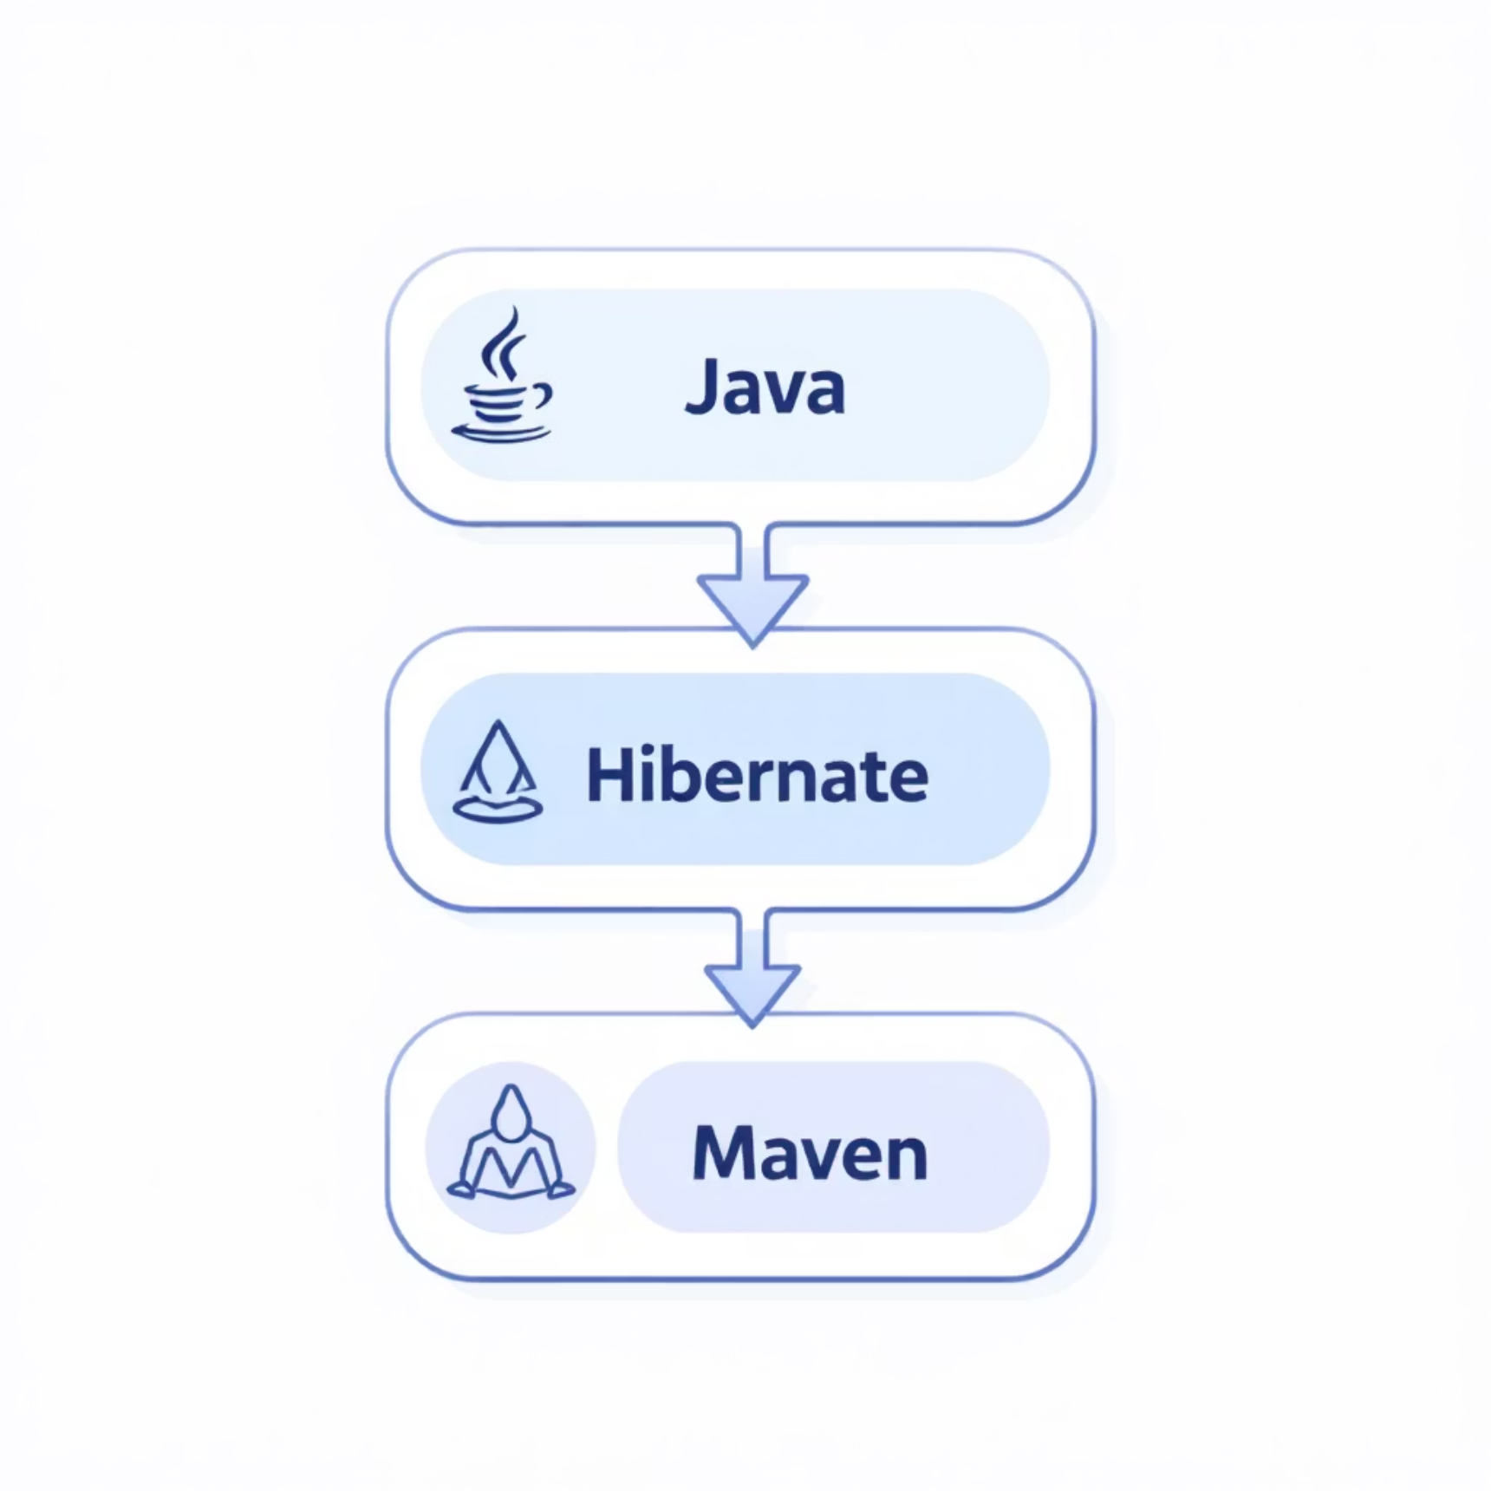



Technology Stack
Java 8+
Core language for application logic and models.
MySQL
Relational database for persistent storage of users, posts and comments.
Hibernate
ORM layer — maps Java entities to database tables and generates schema.
Maven
Dependency management and build lifecycle.
This combination prioritises reliability, familiarity for Java developers, and a clear separation between code and database concerns.

Slide 5
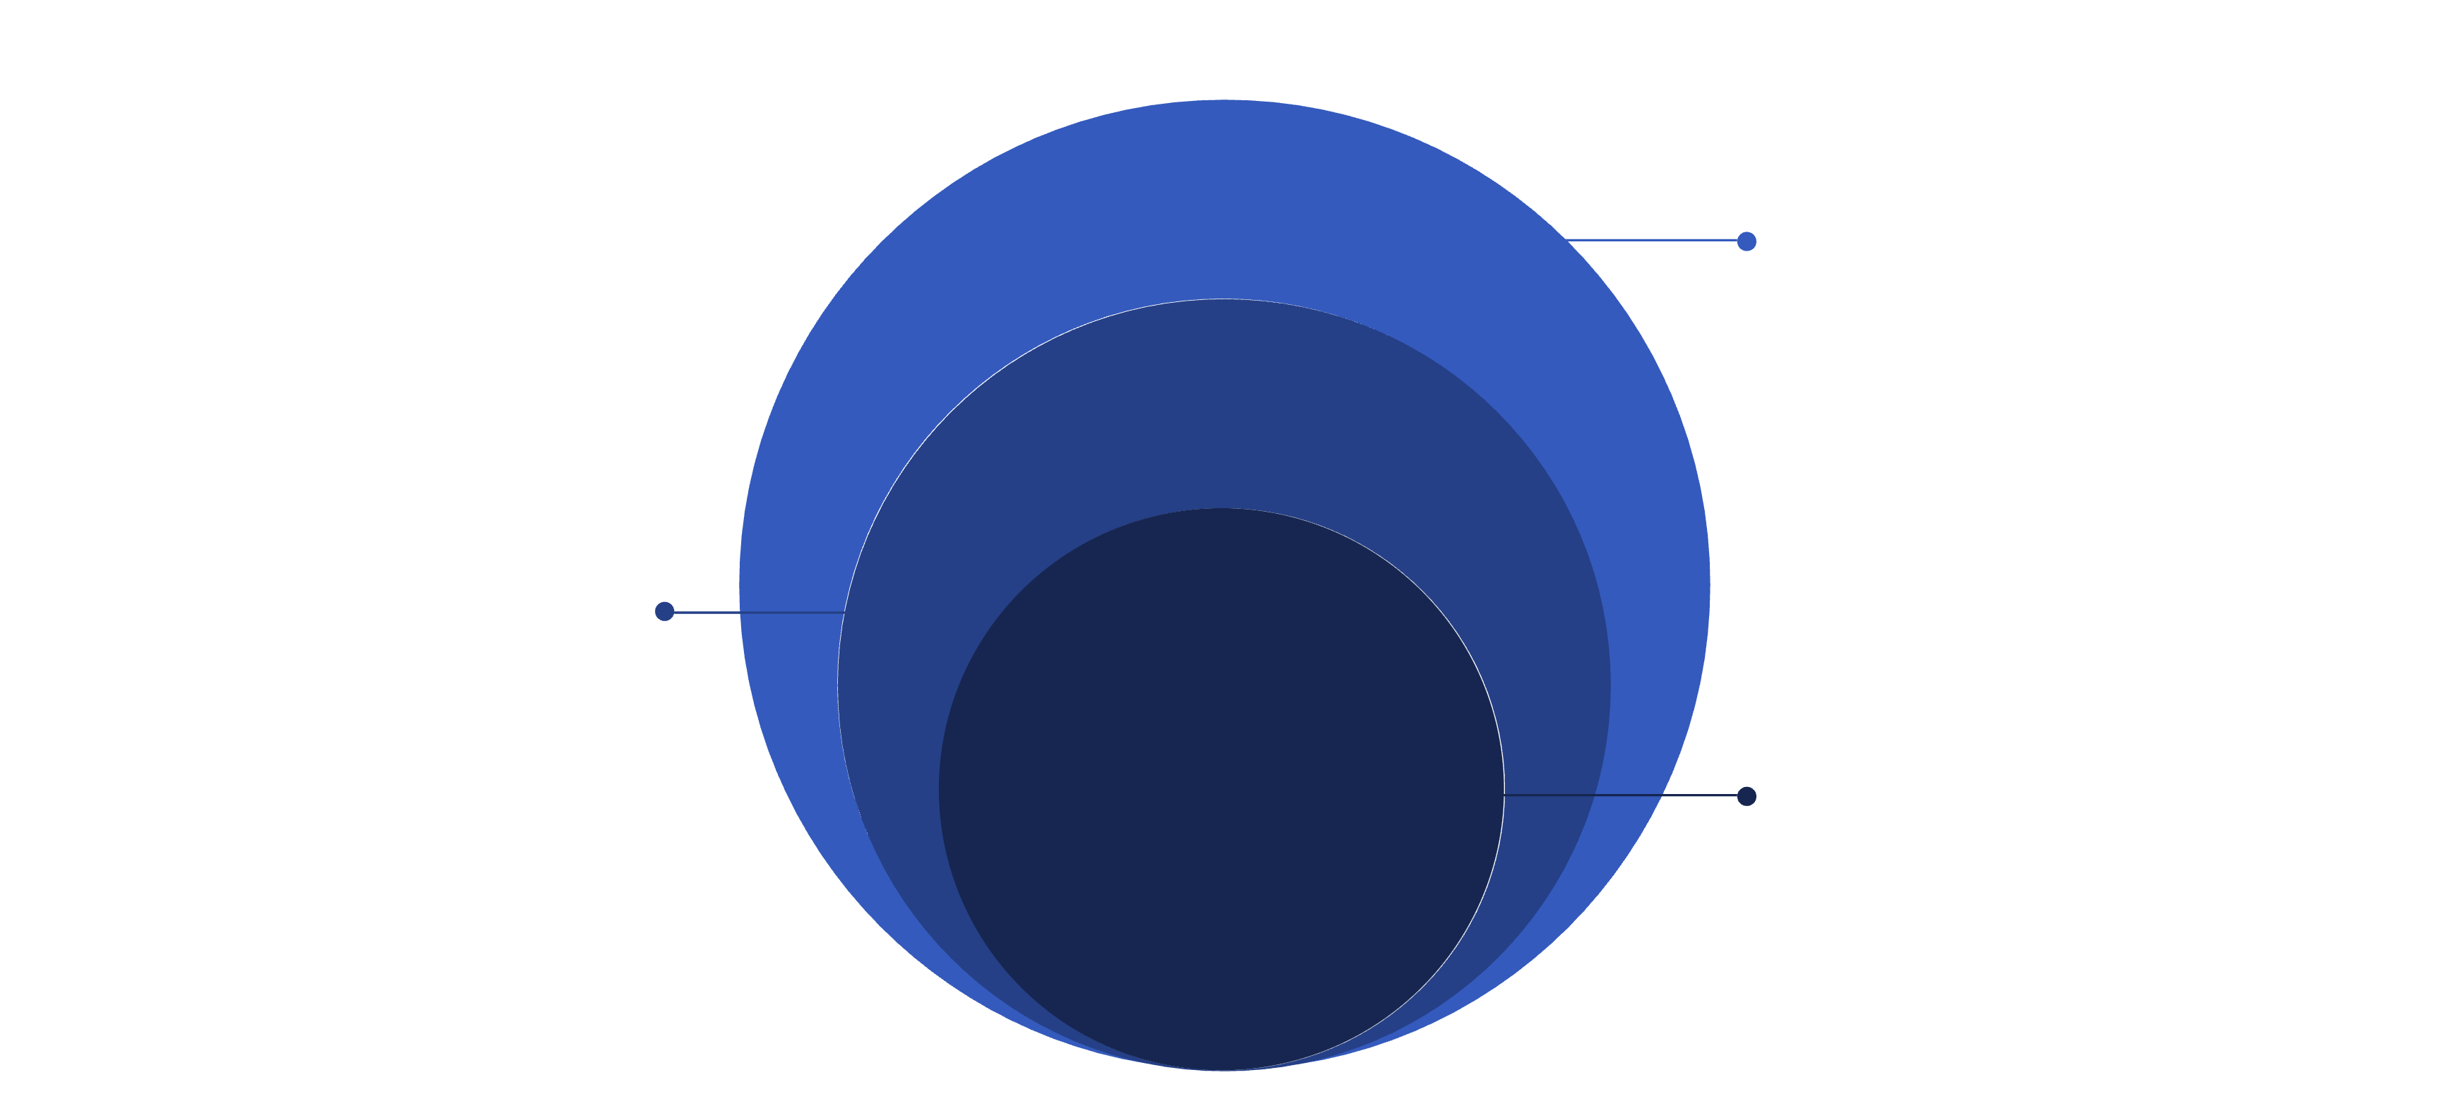
The Layered Architecture (How it’s organised)
DAO & Entities
DAOs access DB; Entities: User, Post, Comment
Service Layer
UserService and PostService implement business rules
Presentation
App.java handles UI and controllers
Four layers enforce single responsibility and make it easy to change the UI without modifying business rules or database code. Colour accent: #3257b8ff highlights layer titles and arrows.

Slide 6
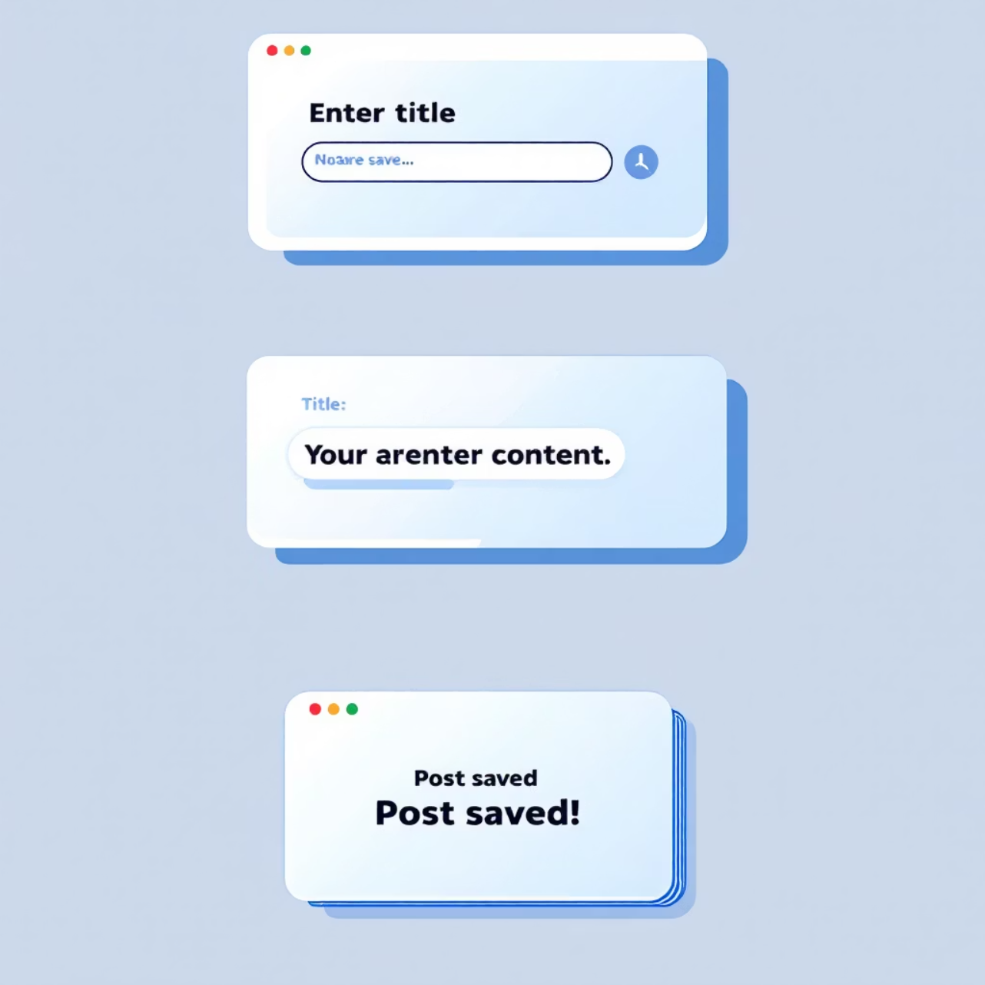
Data Flow Example — Create Post
Step 1 — UI: App.java collects title and content from the user.
Step 2 — Service: postService.createPost(title, content, currentUser) constructs a Post object and applies business rules (author assignment, validation).
Step 3 — DAO: postDao.savePost(newPost) is called. DAO opens a Hibernate Session and persists the entity.
Step 4 — Database: Hibernate converts the entity to an INSERT SQL statement and writes to the posts table.
This pipeline keeps business rules centralised and ensures persistence concerns are isolated to DAOs.

Slide 7
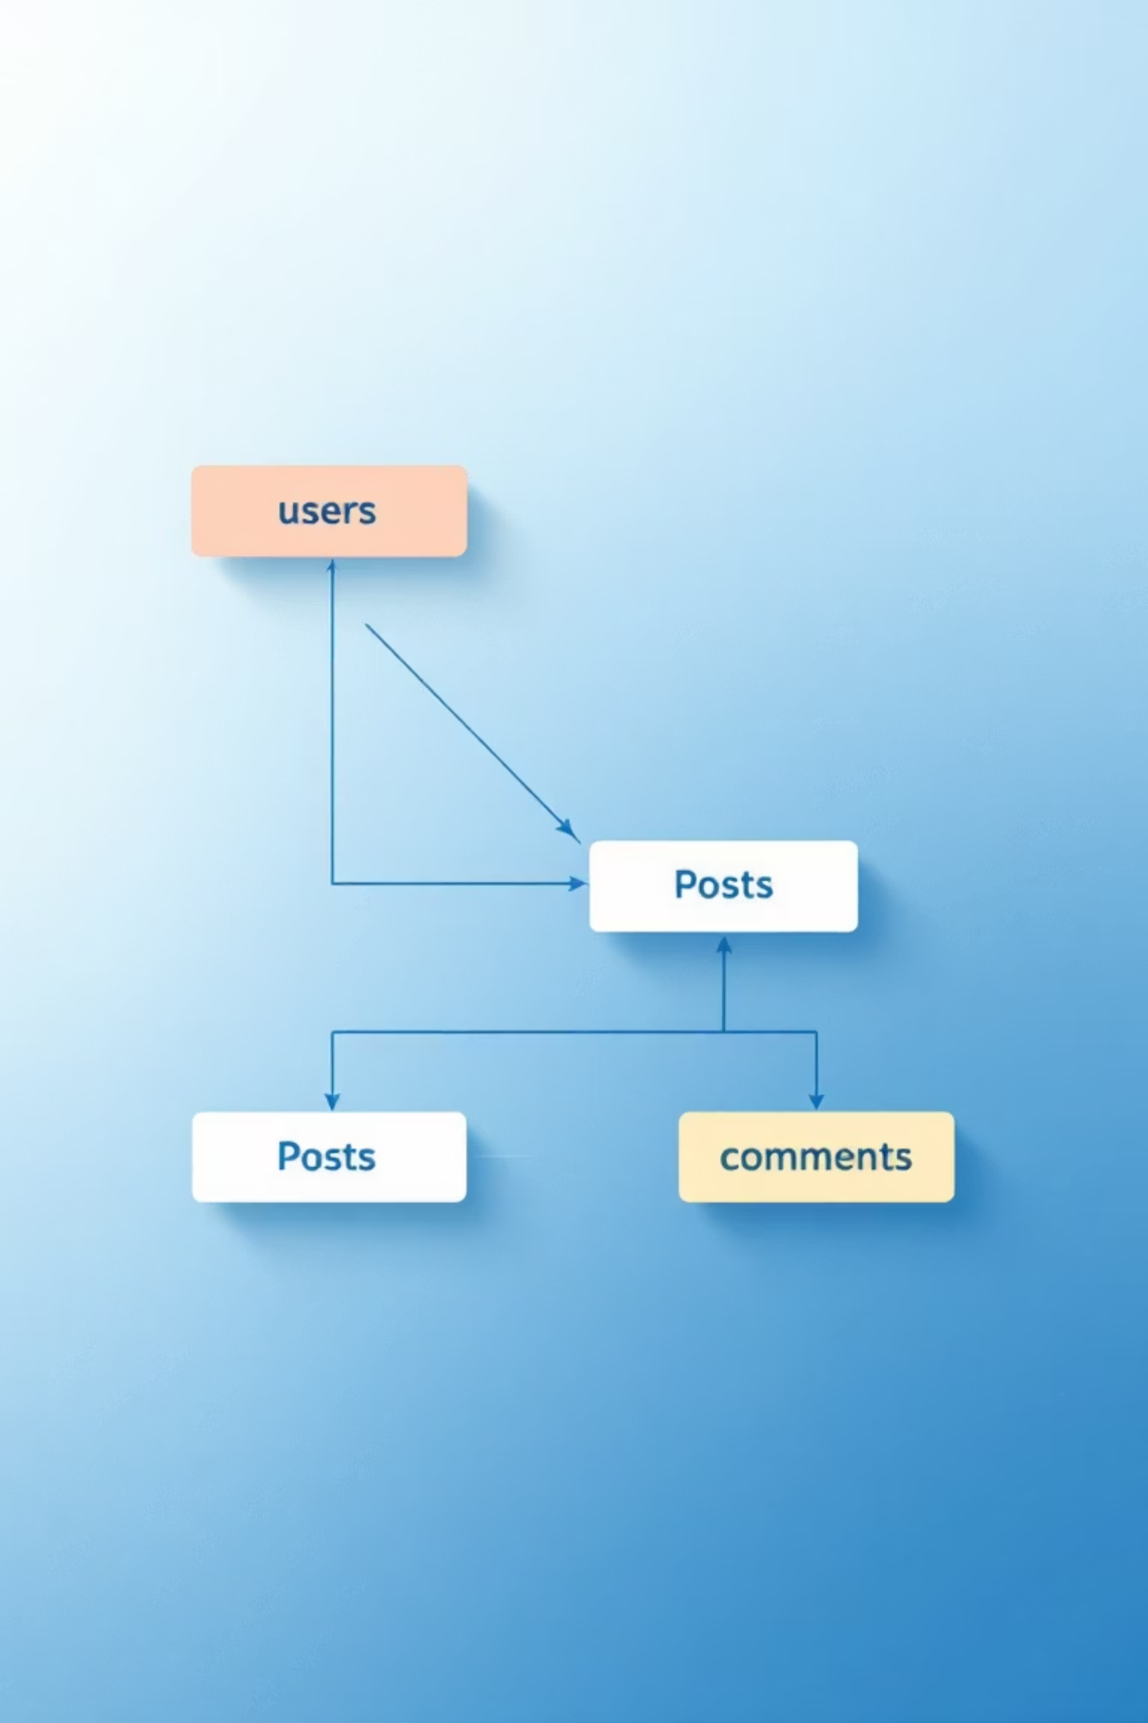
Database Design
The schema derived from entities includes three principal tables: users, posts and comments. One-to-many relationships: user -> posts, post -> comments. Corresponding many-to-one mappings exist on Post and Comment entities for author and parent post.

Slide 8


Live Demonstration — Script
1
2
Register & Login
Create & View Post
Register user 'Alice' then log in to start a session.
Create 'My First Post' and verify it appears in the posts list with author 'Alice'.
3
4
Second User & Comment
Ownership & Delete
Register 'Bob', log in as Bob and add a comment to Alice's post; confirm visibility.
Log back in as Alice and delete the post. Service layer enforces that only the author may delete it.

Slide 9


Challenges & Future Improvements
Hibernate mapping of One-to-Many relationships required careful annotation to avoid cascade and orphan issues.
Managing Hibernate Sessions to prevent LazyInitializationException when accessing lazy-loaded collections.
Console UI limits usability; session handling must be explicit in the app flow.
Planned improvements: add password hashing and salting for security, migrate to a web UI (Spring Boot + Thymeleaf or React), add post editing, user profiles and search functionality.

Slide 10

Conclusion & Q&A
The project demonstrates a robust, layered blog platform implemented with Java, Hibernate and Maven. It emphasises separation of concerns, maintainability and clear data flow. Thank you — I’m happy to answer questions or walk through code snippets.

